Slide 1

HR DATA ANALYSIS
Sreeja Reddy Singidi
Nikroshitha A Notani
Sri Vamshi Polela

Slide 2
Introduction
In the realm of Human Resources (HR), data analysis has become an invaluable tool for organizations seeking to optimize talent management, improve employee engagement, and drive data-driven decision-making.
The purpose of this write-up is to provide a contextual understanding of HR data analysis and its broader landscape, using insights from the selected articles.
Additionally, we will explore how these insights can enhance our group project on HR data analysis.

Slide 3




Source
Kaggle
https://www.kaggle.com/datasets/saadharoon27/hr-analytics-dataset

Slide 4
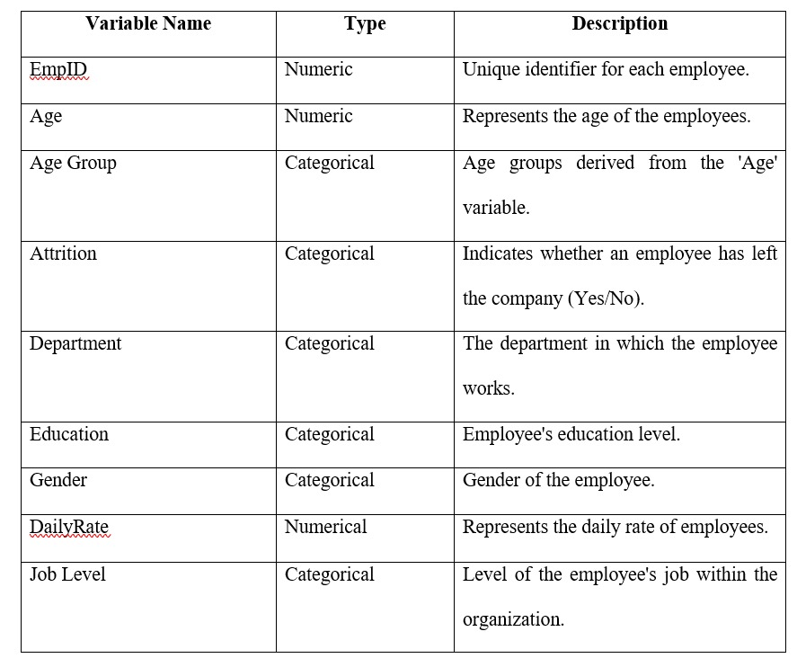
Relevant Variables

Slide 5
Data Preparation:
- Checked for zeros: Ensured that numeric variables didn't have unexpected zeros.
- Checked for null values: Identified and addressed missing values to maintain data integrity.
- Checked for duplicates: Ensured uniqueness in variables like EmpID and EmployeeNumber.
- Detected outliers: Examined numeric variables for extreme values that could affect analysis.

Slide 6

Research questions

Slide 7
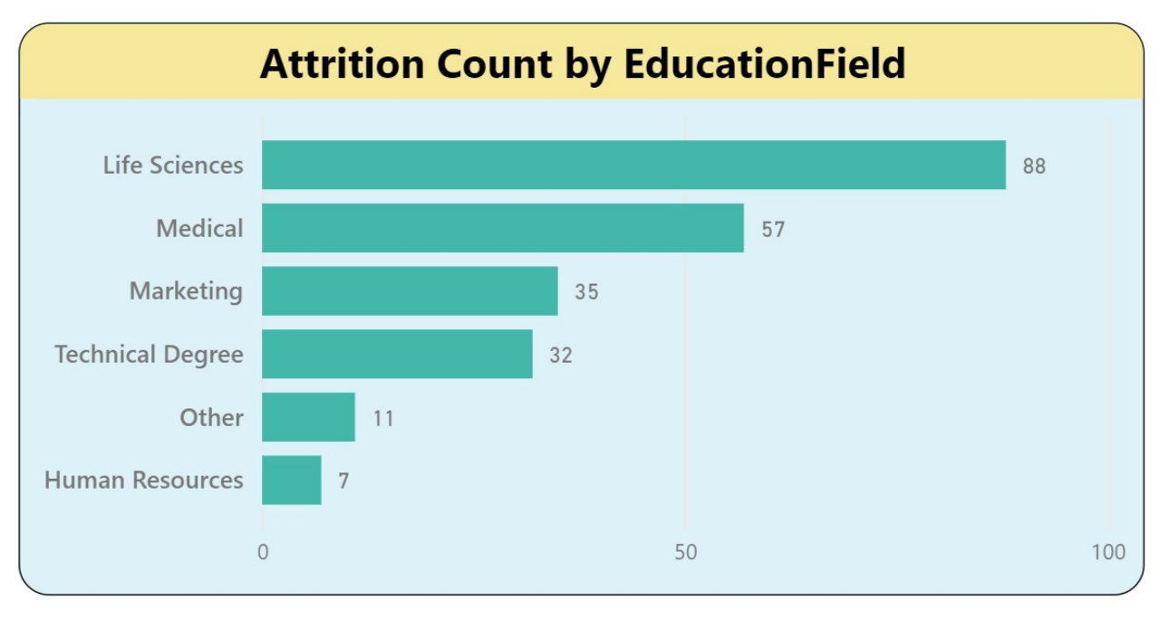
1. Attrition count by Education Field
Research Question: How does employee attrition vary across different education fields, and are there specific fields that exhibit higher attrition rates?

Slide 8
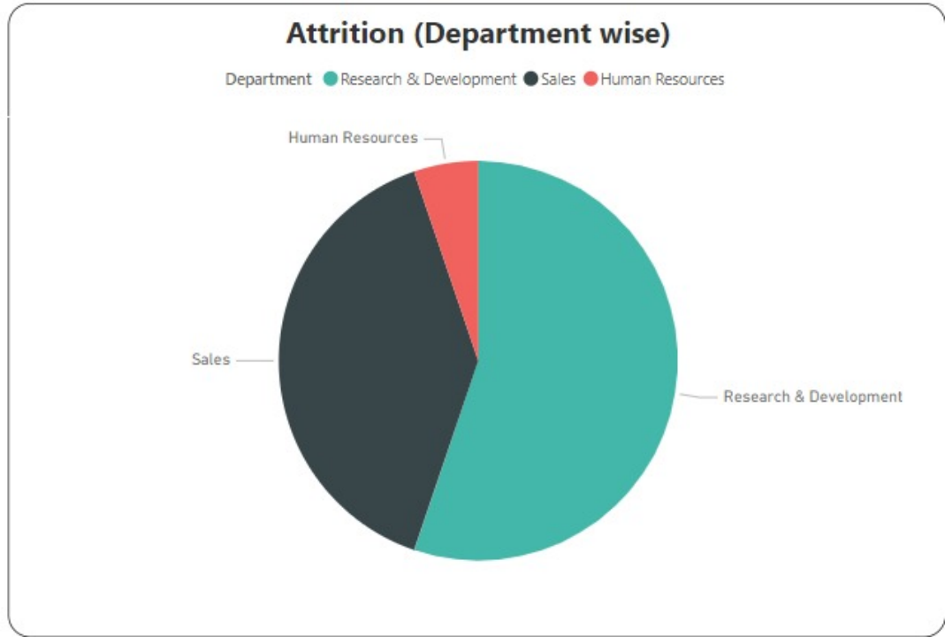
2. Attrition department wise
Research Question: What is the department-wise distribution of employee attrition, and are certain departments more susceptible to attrition than others?

Slide 9
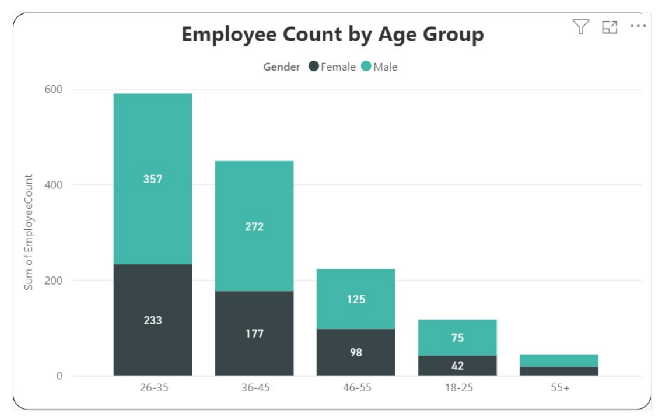
3. Employee count by age group:
Research Question: What is the distribution of employees across various age groups, and does the organization have a balanced representation across different age demographics?

Slide 10
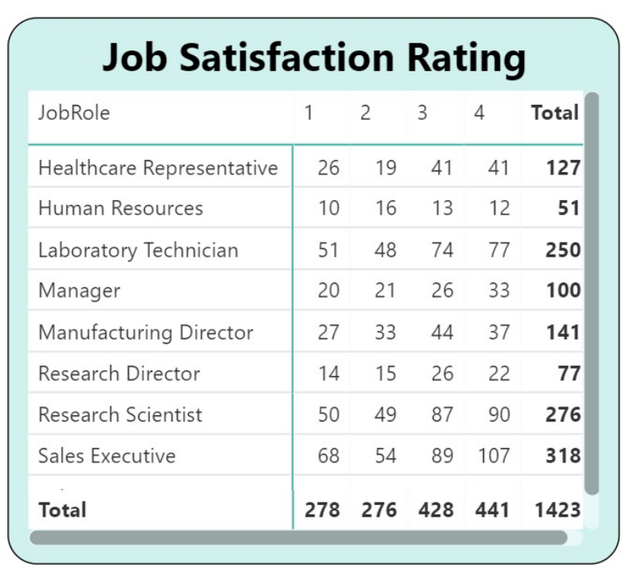
4. Job Satisfaction Rating
Research Question: How do employees rate their overall job satisfaction, and what factors contribute to higher or lower levels of job satisfaction within the organization?

Slide 11
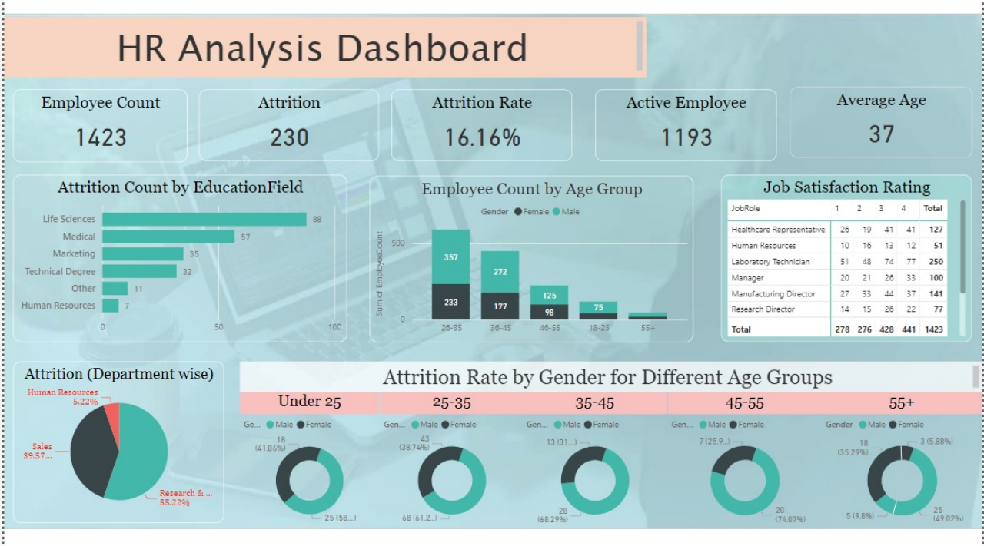

Slide 12

Observations and Insights
Age Trends
Attrition Patterns
Job Satisfaction Correlations
Gender-Age Attrition Dynamics

Slide 13
Conclusion
The exploration of HR data through visualizations has provided valuable insights into various aspects of the workforce.
Examining employee demographics by age group supports the development of inclusive HR policies.
Job satisfaction visualizations contribute to enhancing employee engagement and well-being.
Exploring attrition rates by gender and age group aids in addressing diversity challenges.
Additionally, visualizing key variables like MonthlyIncome and DistanceFromHome provides a comprehensive understanding of factors influencing HR dynamics.

Slide 14

Thank You

